Slide 1
Lecture 22
Comparing the Means of Two Normal Distributions
The F Distribution
Comparing the Variances of Two Normal Distributions

Slide 2



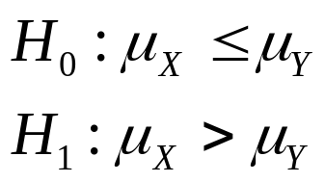
Comparing the Means of
Two Normal Distributions
Suppose that X1,…,Xm form a random sample of m observations from a normal distribution for which both the mean and the variance are unknown, suppose also that Y1,…,Yn form a random sample of n observations from a normal distribution for which both the mean and the variance are unknown. Suppose the following hypotheses are to be tested at a specified level of significance α0 :

Slide 3
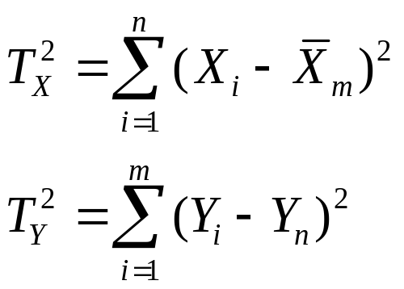
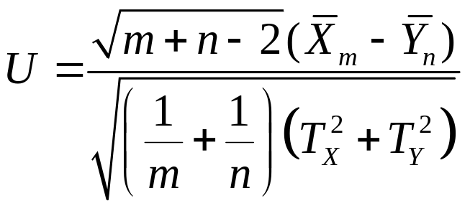

Define
The test statistic we will use is
We will consider the test that rejects H0 when .

Slide 4
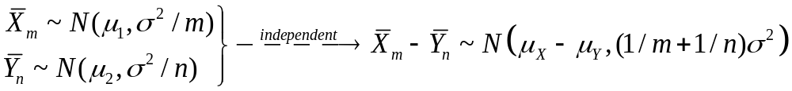

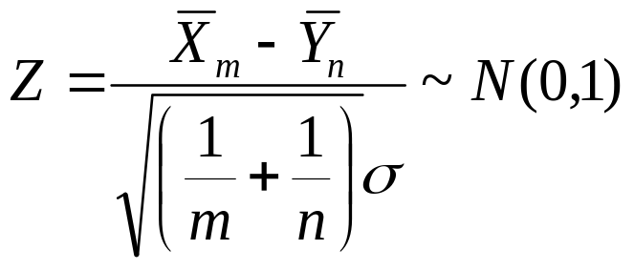
When , we have

Slide 5
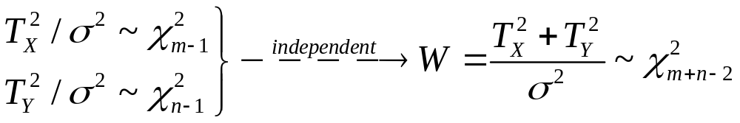
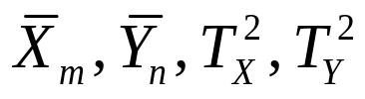
Because are independent, Z and W
are independent.

Slide 6
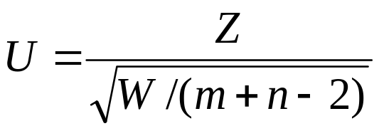
So when , the statistic
will have a tm+n-2 distribution.

Slide 7
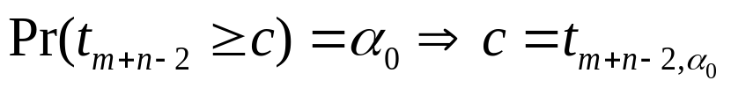
Note that
So the size of the test is
Given a significance level α0, we can choose a constant c such that

Slide 8

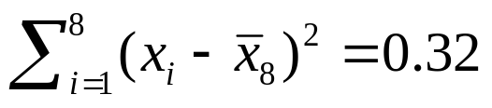

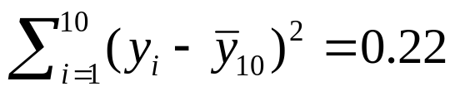
Example
A random sample of 8 specimens of ore is collected from a certain location in a copper mine, and that the amount of copper in each specimen is measures in grams. We denote these 8 amounts by X1,…,X8. Suppose that it is found that and
.
Another random sample of 10 specimens or ore is collected from another part of the mine, and the amounts of copper in these specimens are denoted by Y1,…,Y10 . Suppose that it is found that and

Slide 9
Example
Let denote the mean amount of copper in all the ore at the first location in the mine, and let denote the mean amount of copper in all the ore at the second location.
We shall carry out an t test of the hypotheses

Slide 10
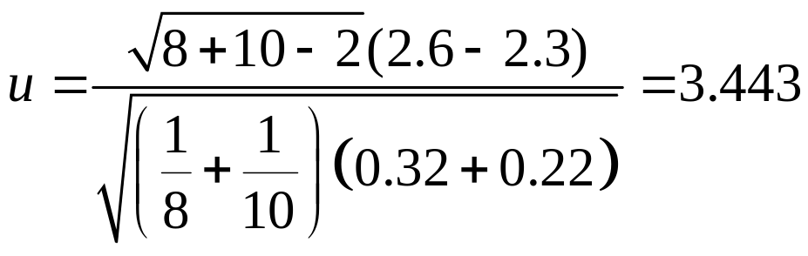

Solution:
  Assume that all the observations have a normal distribution and that the variance is the same at both locations in the mine.
  Then
  It can be found that the p-value is
  So the null hypothesis will be rejected for any specified level of significance α0>0.00167.

Slide 11
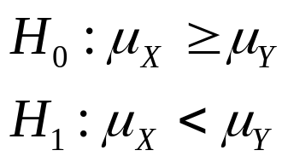
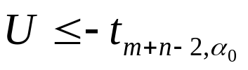
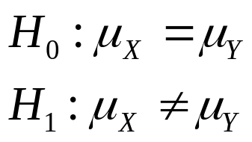
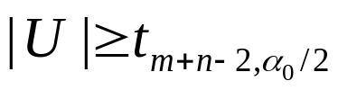
The Other One-Sided Hypotheses and Two-Sided Hypotheses
If we want to test the hypotheses
The level α0 t test rejects H0 when
If we want to test the hypotheses
The level α0 t test rejects H0 when

Slide 12
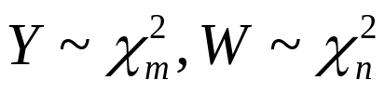
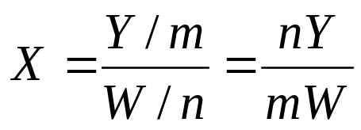
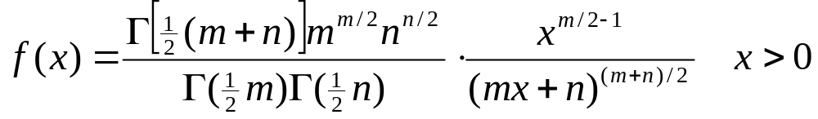
The F distribution
Consider two independent random variables Y and W, such that . Define
Then the distribution of X is called an F distribution with m and n degrees of freedom.

Slide 13
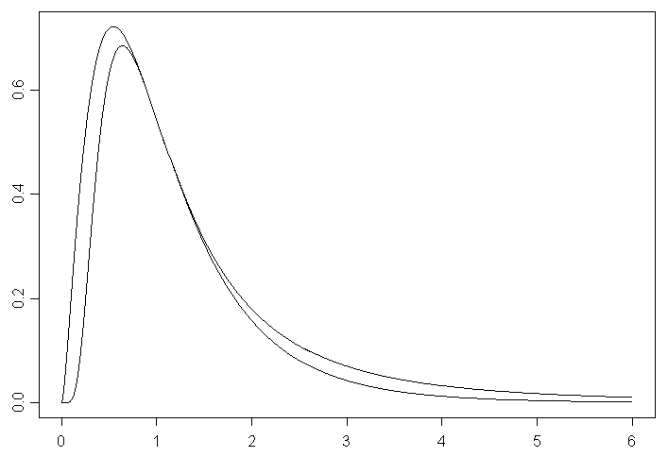
m=5,n=20
m=20,n=5

Slide 14

Properties of the F distribution
If a random variable X has an F distribution with m and n degrees of freedom, then 1/X will have an F distribution with n and m degrees of freedom.
If a random variable X has a t distribution with n degrees of freedom, then will have an F distribution with 1 and n degrees of freedom.

Slide 15


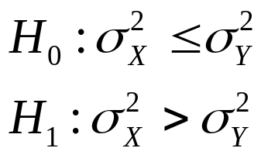
Comparing the Variance of
Two Normal Distributions
Suppose that X1,…,Xm form a random sample of m observations from a normal distribution for which both the mean and the variance are unknown, suppose also that Y1,…,Yn form a random sample of n observations from a normal distribution for which both the mean and the variance are unknown. Suppose the following hypotheses are to be tested at a specified level of significance α0 :

Slide 16
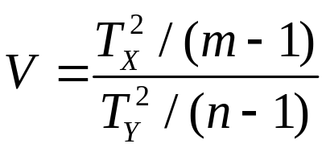

Define
The test statistic we will use is
We will consider the test that rejects H0 when .

Slide 17
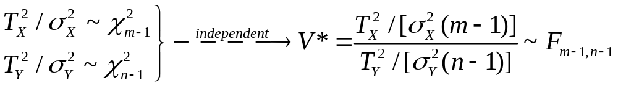
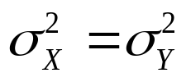
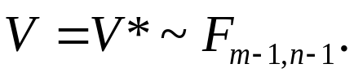
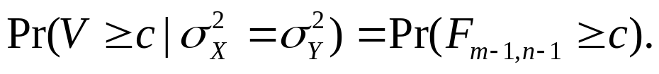
When ,
Hence

Slide 18
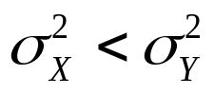
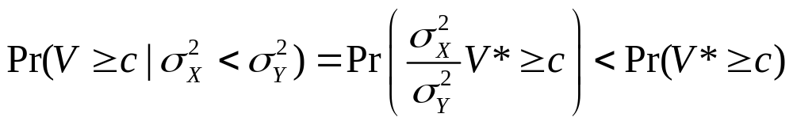
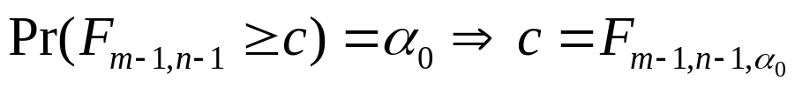
Note that when
So the size of the test is
Given a significance level α0, we can choose a constant c such that

Slide 19
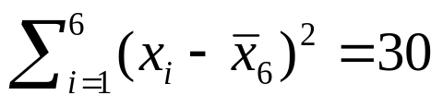
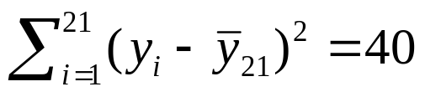
Example
Suppose that 6 observations X1,…,X6 are selected at random from a normal distribution for which both the mean and the variance are unknown, and suppose that it is found that . Suppose also that 21 observations Y1,…,Y21 are selected at random from another normal distribution for which both the mean and the variance are unknown, and suppose that it is found that
. We shall carry out an F test of the hypotheses

Slide 20
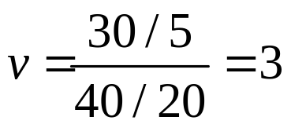
The value of V for the given example is
It is found from the F tables that the 0.05 upper quantile of the F distribution with 5 and 20 degrees of freedom is 2.71, and the 0.025 upper quantile is 3.29.
Hence, the hypothesis H0 should be rejected at the level of significance α=0.05 and should not be rejected at the level of significance α=0.025.

Slide 21
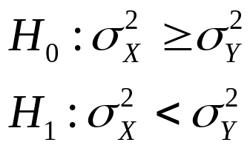
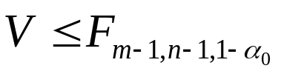
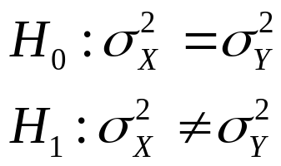
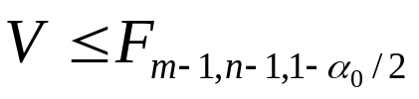
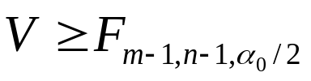
The Other One-Sided Hypotheses and Two-Sided Hypotheses
If we want to test the hypotheses
The level α0 F test rejects H0 when
If we want to test the hypotheses
The level α0 F test rejects H0 when
or

Slide 22
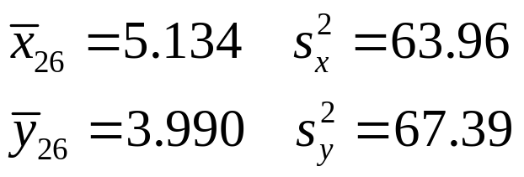
Example
Let X1,…X26 be the log-rainfalls of the 26 seeded clouds, and let Y1,…,Y26 be the log-rainfalls of 26 unseeded clouds. The observed values of sample statistics are
We want to test the hypotheses
at level of significance α0=0.05.

Slide 23
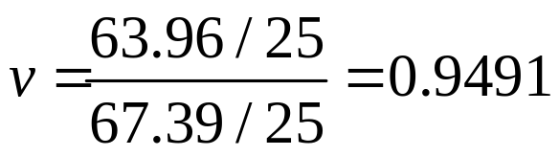
The value of V for the given example is
It is found from the F tables that the 0.975 and 0.025 upper quantiles of the F distribution with 25 and 25 degrees of freedom are 0.4484 and 2.2303.
Hence, the hypothesis H0 should not be rejected at the level of significance α=0.05.

